Slide 1
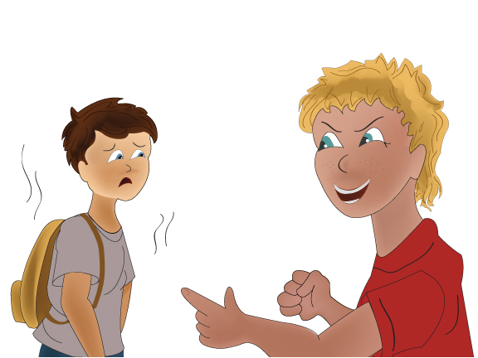
Handling Bullying
Notes:
Please see the How to Use Personalized Stories document for more information on how to edit and display this PowerPoint presentation for your child.
Please customize this template to best help your child by:
Modifying the template to use your child’s name
Using language that is familiar to your child
Including items that are of great interest to your child
Adding photos of your child or family to all of the blue frames in this template.
Adding photos and new slides from your own child’s life to this template.
Changing any of the text, photos, or images in this template with photos or images that are more meaningful to your child

Slide 2
Some children try to bully other children. Bullying can happen to anyone.

Slide 3
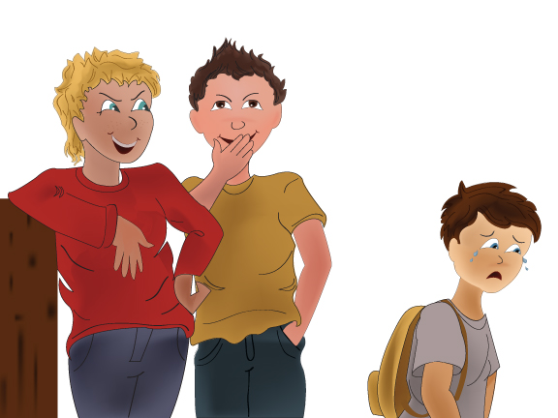
Bullies may say mean things, call names, make fun of, tease, ignore or spread false rumors about others.

Slide 4
Bullies may push, punch, shove, or take things from others.

Slide 5
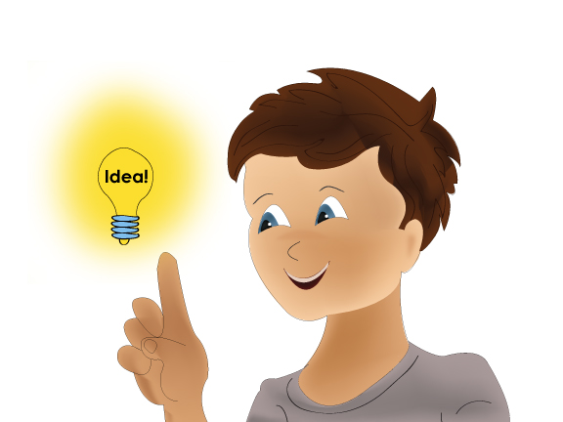
Bullying usually happens when an adult is not around. I must learn how to recognize and handle bullies.

Slide 6
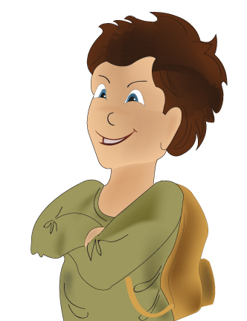
To avoid getting bullied, I can walk with confidence, holding my head high, keeping a straight back and a calm face.
Bullies are more likely to pick on me if they think I am frightened.

Slide 7
Walk around the school with friends. Be kind and respectful toward other people. Bullies are less likely to approach when I walk around in a group and have lots of friends.

Slide 8
Be aware of my surroundings. Try to avoid the bully by going somewhere else, always staying calm and confident.

Slide 9
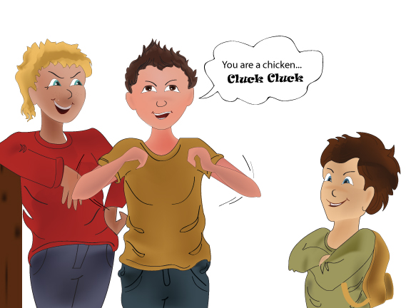
I can ignore the bully. Bullies want me to act frightened or scared. A bully might continue talking. I don’t need to respond.

Slide 10
If the bully continues to hurt me in any way, I can yell “NO” using a firm voice so others can hear me.
I can also say “STOP! I DON’T LIKE THAT!”

Slide 11
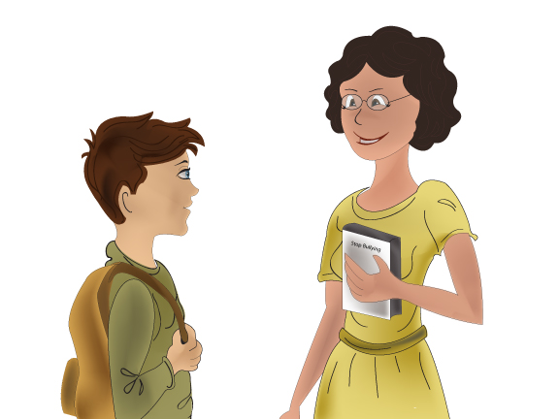
I can go to a teacher or another adult for help.

Slide 12
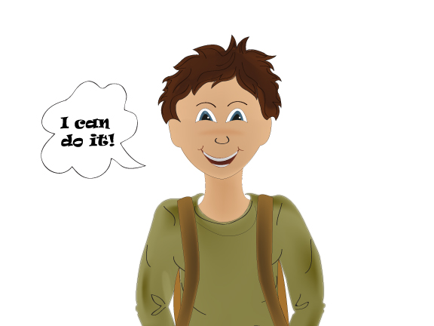
Bullying will not stop unless I stand up against it. I need to make a plan and take action against bullying. I CAN DO IT!!!

Slide 13
Things to Try
Sometimes, I might see or hear about a friend being bullied. It feels good to help others. Here is what I can do to help a friend being bullied:
Go with my friend to a safer place.
Tell the bully to STOP!
Go with my friend to tell an adult.
Go on my own to tell an adult.

